Slide 1
Python Preparation Assignment
J. Pretorius
15603962

Slide 2
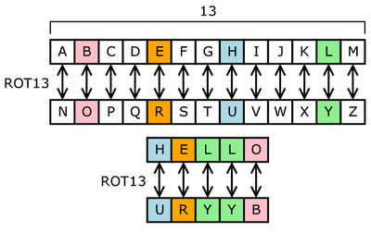
Part 1:
ROT13

Slide 3
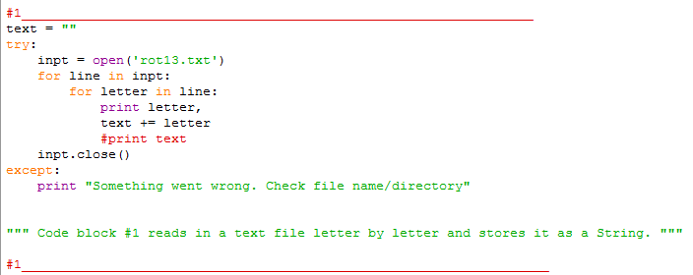
“…write a Python program to both encode and decode ROT13.”
1.
Each character in source file
Code block #1 reads in a text file (character by character) and stores each character in a string.

Slide 4
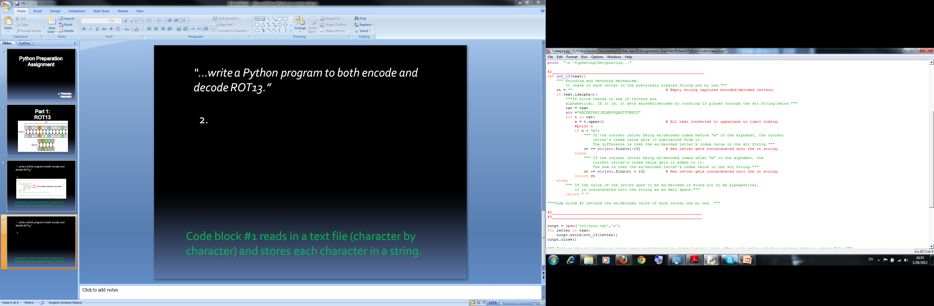
“…write a Python program to both encode and decode ROT13.”
2.
Isalpha ensures that all characters read in from the file is found in the [A-Z] and [a-z] brackets.

Slide 5
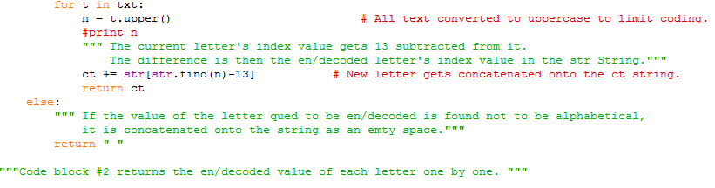
“…write a Python program to both encode and decode ROT13.”
3.
Each compatible character is iterated over, converted to uppercase, index found and its ROT13 value is then found and added to a string. If a character is not compatible, it is removed.

Slide 6
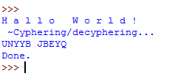
“…write a Python program to both encode and decode ROT13.”
4.

Slide 7
Part 2:
RE Module

Slide 8
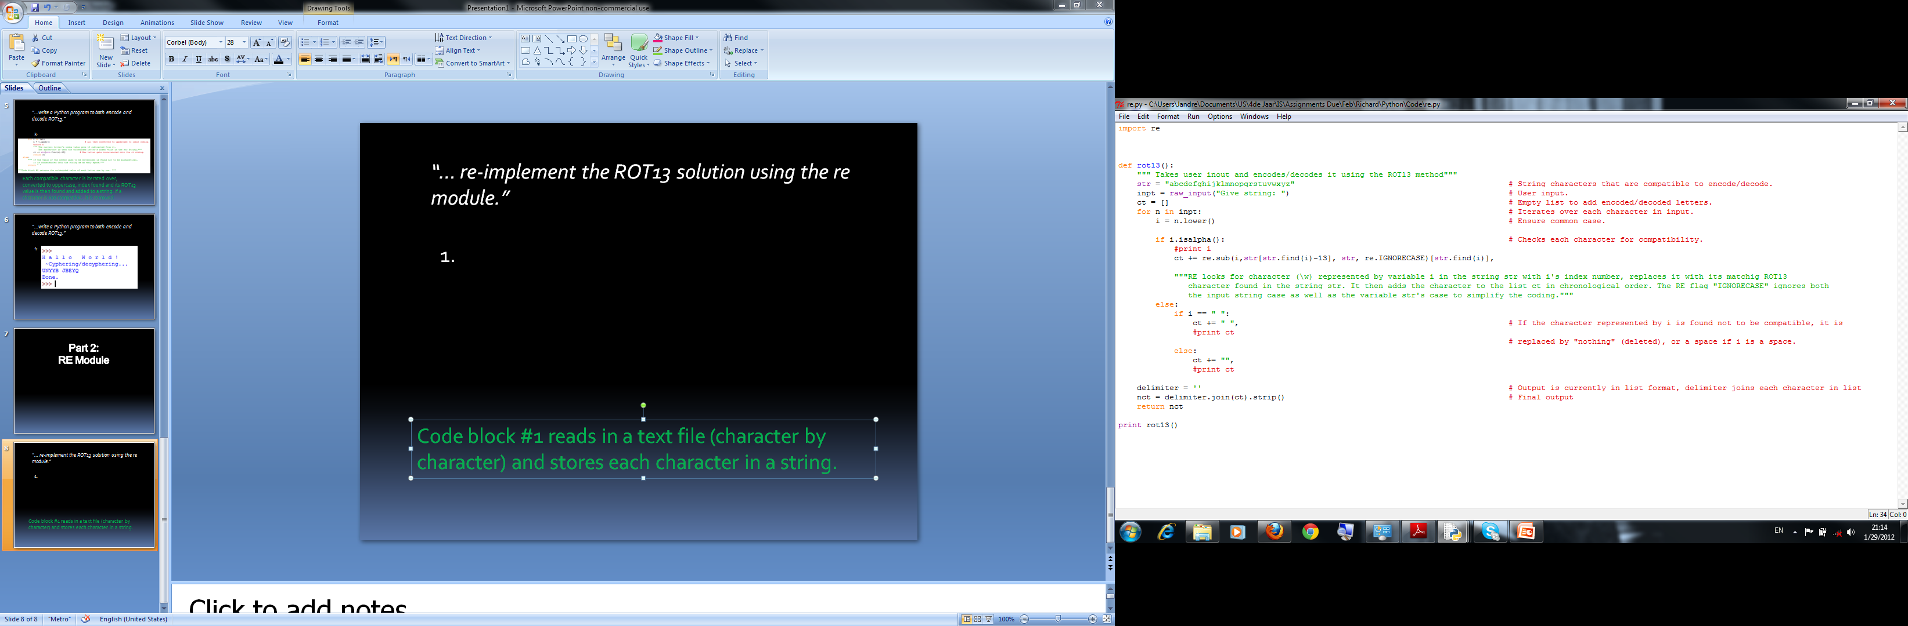
“… re-implement the ROT13 solution using the re
module.”
1.
Imported the re module and used the sub function to find a given character in a string and then replace it with it’s ROT13 value

Slide 9
“… re-implement the ROT13 solution using the re
module.”
2.
Find
Replace with
Find where
Flag
RE looks for character (\w) represented by variable i in the string str with i's index number, replaces it with its matching ROT13 character found in the string str.

Slide 10
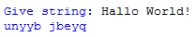
“… re-implement the ROT13 solution using the re
module.”
3.

Slide 11
Part 3:
Base64

Slide 12
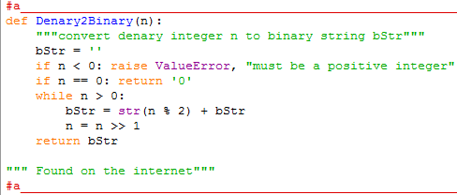
“… write a program to encode and decode text into Base64 based on the MIME variant..”

Slide 13
“… write a program to encode and decode text into Base64 based on the MIME variant..”
Formula to convert integer in to binary

Slide 14
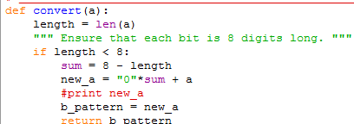
“… write a program to encode and decode text into Base64 based on the MIME variant..”
Could not get the padding aspect working, this piece of code was the closest I could get to it.

Slide 15
“… write a program to encode and decode text into Base64 based on the MIME variant..”
Each character’s binary value is measured and if it is not 8 characters long, zero’s get added to the front of each binary 0f the binary segments.

Slide 16
“… write a program to encode and decode text into Base64 based on the MIME variant..”
Convert() returns a string of binary for each character that is 8 digits long.

Slide 17
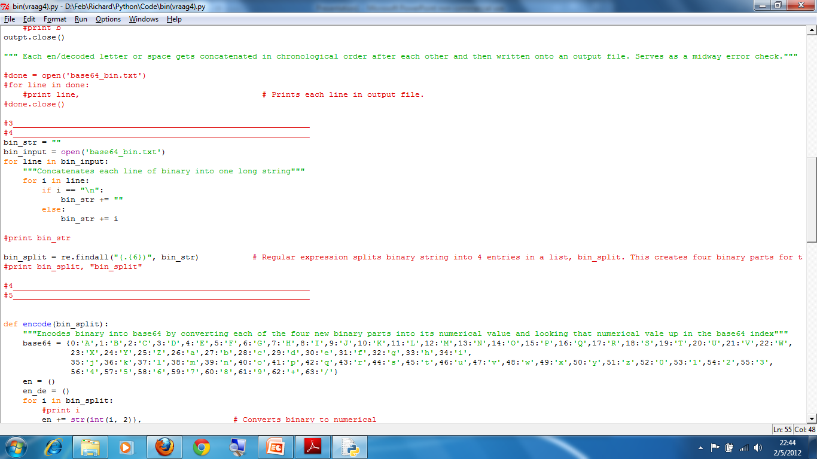
“… write a program to encode and decode text into Base64 based on the MIME variant..”
Code concatenates each line of binary into one long string.

Slide 18
“… write a program to encode and decode text into Base64 based on the MIME variant..”
Findall splits binary string into segments of 6 digits

Slide 19
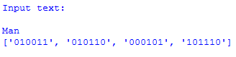
“… write a program to encode and decode text into Base64 based on the MIME variant..”
Output so far.

Slide 20
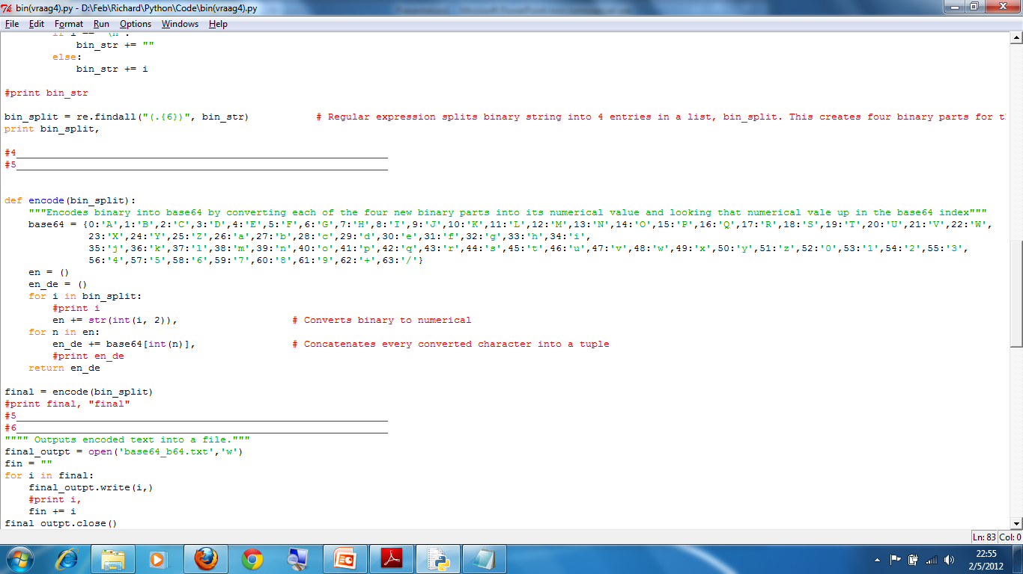
“… write a program to encode and decode text into Base64 based on the MIME variant..”
Base64 index table.
Converts binary to
integer.
Looks up int in
Base64 dictionary.
Returns tuple with
Each encoded
Character.

Slide 21
“… write a program to encode and decode text into Base64 based on the MIME variant..”
Built in function “int” converts binary into integer value using the an algorithm.

Slide 22
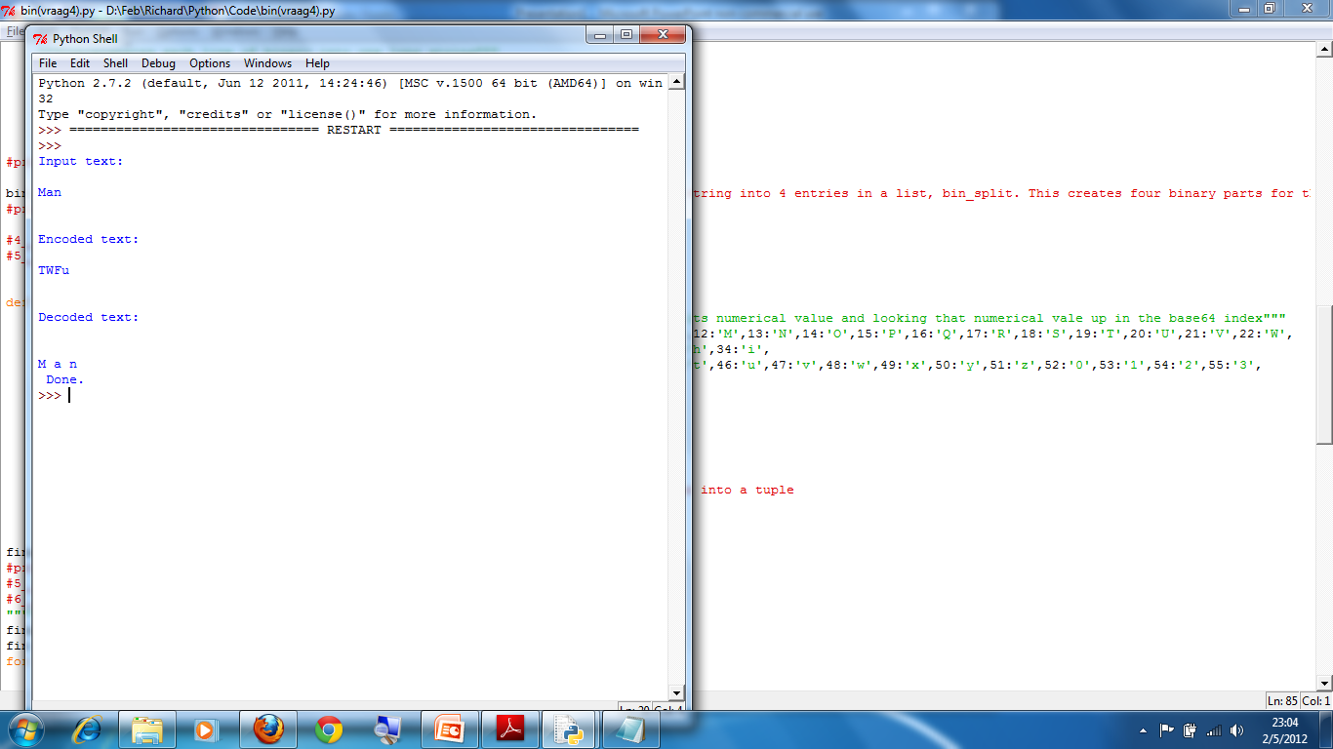
“… write a program to encode and decode text into Base64 based on the MIME variant..”
Output so far.

Slide 23
“… write a program to encode and decode text into Base64 based on the MIME variant..”
The output is now in encoded form. To decode from this form, the opposite must now tale place.
Each character’s base64 index value must be found
These integers must be converted to binary
Each binary string must be 6 digits long, if they are not, leading zero’s must be added.

Slide 24
“… write a program to encode and decode text into Base64 based on the MIME variant..”
A long string of binary is created and then split into segments of 8 digits.
These 8 digit binary segments must then be converted into integers.
These integer’s ASCII values are then the decoded text.

Slide 25
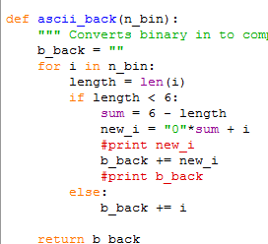
Converts binary in to compatible-length segments

Slide 26
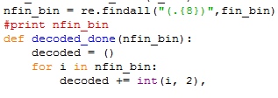
RE splits binary string into segments of 8 digits and the built in “int” function converts binary back to integer.

Slide 27

Returns ASCII value of each integer, thus completing the decoding process.

Slide 28
